Slide 1
Leveraging Rancher Government Solutions within the US Government and Public Sector
Zack Brady | Solutions Architect zack.brady@ranchergovernment.com
CAGE Code: 8GLZ3
DUNS: 117387835

Slide 2

About Me…
Former Government Contractor
U.S. Military Reservist (USN)
Built/Exited a Digital Firm
Open-Source Contributor
Career of DevOps/SWE
Active Volunteer FF/EMT
Connect with me!
https://github.com/zackbradys
https://linkedin.com/io/zackbradys

Slide 3
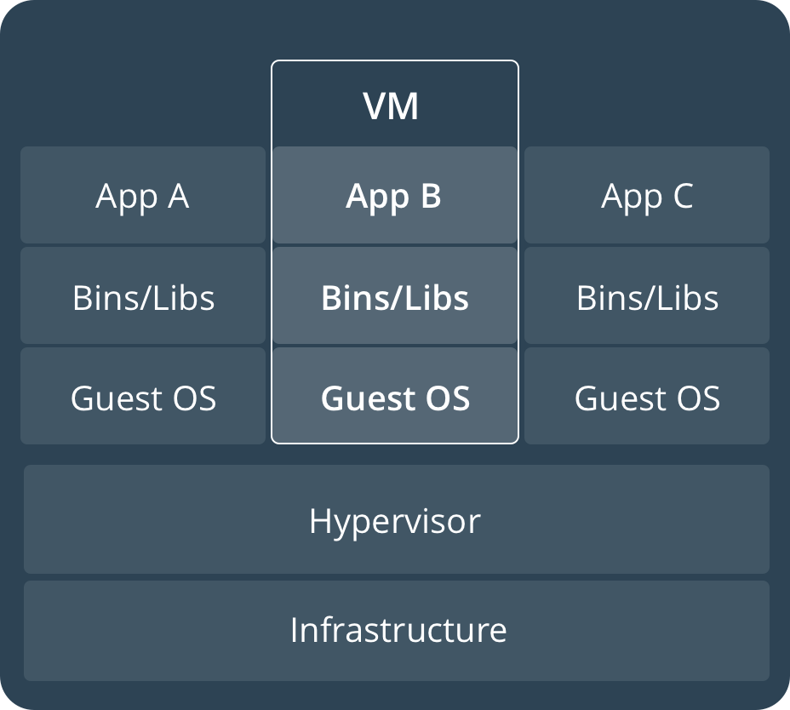
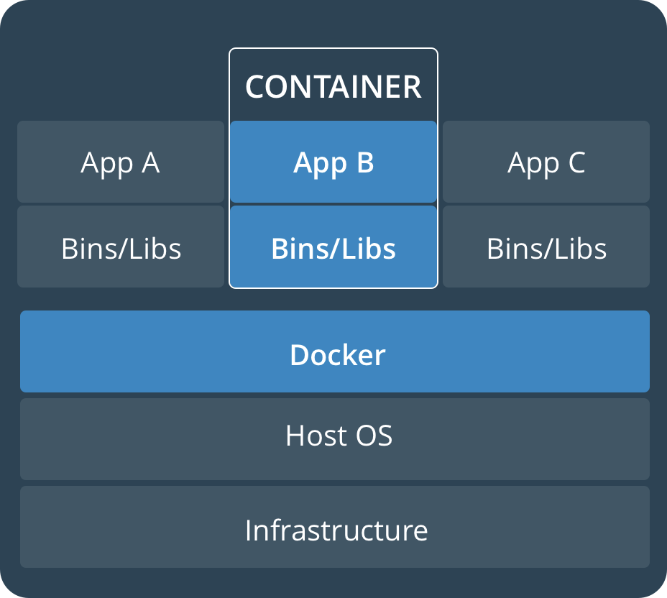
Virtual Machines vs Containers
Notes:
‹#›

Slide 4
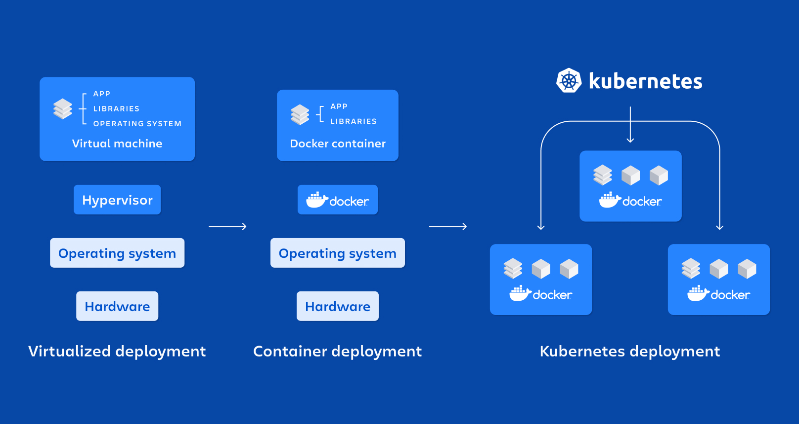
VMs -> Containers -> Kubernetes!
Notes:
‹#›

Slide 5

Rancher Government Solutions (RGS)
STIG/CIS Hardening & Validation
SELinux and FIPS-2/3 Compliance
Engineering Cloud Native Computing Platforms for the US Government
Enterprise Monitoring & Audit Functionality
Rancher Government Solutions is an Enterprise Software company that focuses solely on US Government Missions. Fueled by the innovation of our upstream Rancher Open-Source communities, our Enterprise Platform offerings are security hardened and ready for deployment on any US Government mission critical system.
RGS is a wholly owned subsidiary to SUSE. RGS is the only entity within SUSE that is authorized to sell Rancher and SUSE Products to the US Government.
RBAC and PKI Authentication
Air-Gapped , GovCloud, W&S, C2S, SC2S, C2E
Notes:
‹#›

Slide 6



Three Pillars of Customer Success
Go to Market and Accelerate Mission
Product Subscription
Professional Services
Mission Accelerator
Access to Rancher Gov Carbide and the Carbide Secured Registry.
Full Features of Rancher Platform Stack, Liberty Linux, and SUSE SLES.
SLA: 24/7/365 CONUS and U.S Citizen Enterprise Support.
Access to Product Documentation- even in Air Gapped environments
Certified Integration Support for Kubernetes ecosystem offerings.
On-Site, On-Premises, or Remote Cleared Engineers
Rancher Product Stack and Kubernetes SMEs to accelerate customers deployments
Technical Account Managers
Bootstrap Architecture Support combined Technical Enablement and Training Courses
Dedicated Rancher product portfolio that seamlessly deploys in airgap/classified environments
Security first mindset to Rancher by baking in NIST FIPS-140-2/3 encryption & DISA STIG Certification
Collaborated to develop secure by default and secure by default Kubernetes distribution
Cloud to Data Center to Tactical Edge Portfolio Offerings
Notes:
‹#›

Slide 7



Customer Success Stories
Bleeding-edge technology advancing the mission landscape tomorrow
CDC Operation WARPSPEED
USAF Platform-One
U2 Federal Laboratory
(Customer Problem) The U2 Spy Plane has been retrofitted with computational hardware running Rancher’s K3s distribution for cloud-native AI/ML in-flight
(Rancher Federal Solution) Rancher Federal Engineers executed a ‘get-well’ strategy enabling the U2 Fed-lab to modernize a 60-plane into a foundational platform for a modern-day mission weapons platform
(Customer Problem) Platform Engineering contract focused on a ‘Get Well Strategy’ to modernize the CDC’s immunization data lake infrastructure
(Rancher Federal Solution) Rancher Federal Support and Consulting Engineers introduced a hybrid-cloud architecture that migrated CDC workloads from pure AWS -> AWS, Azure, and On-Prem Bare Metal
2 Prime contracts with USAF P1 with 18 FTEs supporting the DevSecOps initiatives and platform infrastructure.
70% of P1 Kubernetes clusters are running Rancher’s RKE2 distribution
Rancher’s k3s distro is shipping on a USAF Edge-One satellite mission in CY2021.
Direct Support: ABMS, F35, INSCOM
C-ATO Approval
Notes:
‹#›

Slide 8






















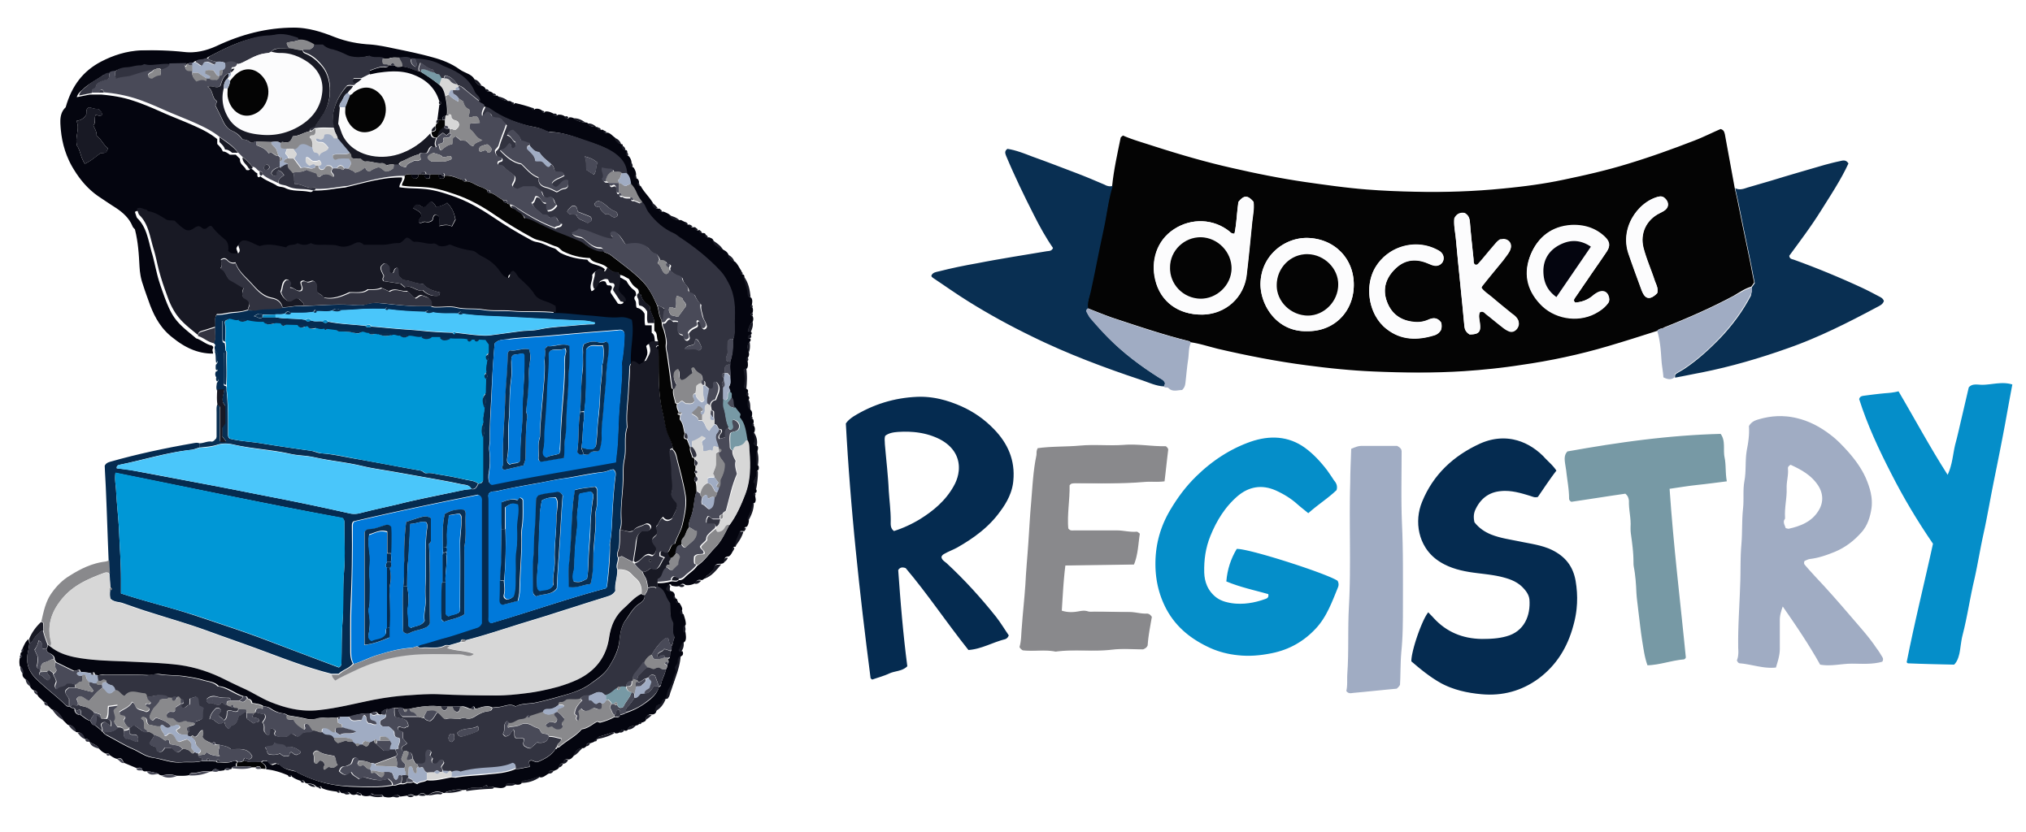



































The Complete Rancher Stack
Rancher Product Stack (RGS SLA)
Certified Partners & Integrations
Authentication/Authorization
App Management & CI/CD
Monitoring & Logging
Registry & Image Scanning
Container Security & Secrets
Networking & Service Mesh
Platforms & Orchestration
GKE
AKS
Persistent Storage
Container Engine
Operating Systems
Infrastructure Drivers
‹#›
Notes:
‹#›

Slide 9

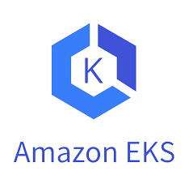









Rancher is Fully Open and Interoperable
Datacenter
Edge
Block Storage
Other Kubernetes Distros
Rancher
2
Azure AKS
Google GKE
Linux Distros
Hybrid Cloud Infrastructure
Notes:
‹#›

Slide 10










Products and Projects
RANCHER
Flagship Product – Rancher Multi-cluster Manager is world’s most popular Kubernetes Management platform
A CNCF-certified Kubernetes distribution that built to the security requirements of the US Government. FIPS 140-2/3, CIS, SELinux.
A CNCF-certified Kubernetes distribution that is easy to install and less than 100MB
HARVESTER
Hyperconverged Infrastructure (HCI) powered by KubeVirt for deploying VMs and Kubernetes
GitOps & Continuous Delivery at scale. Deploy and manage thousands to millions of clusters
Highly available and persistent block storage for microservices-based, stateful applications
NeuVector Full Lifecycle Container Security Platform delivers the only cloud-native security with uncompromising end-to-end protection
‹#›
Notes:
‹#›

Slide 11
















Worried about STIGs? Concerns with ATOs?
‹#›

Slide 12
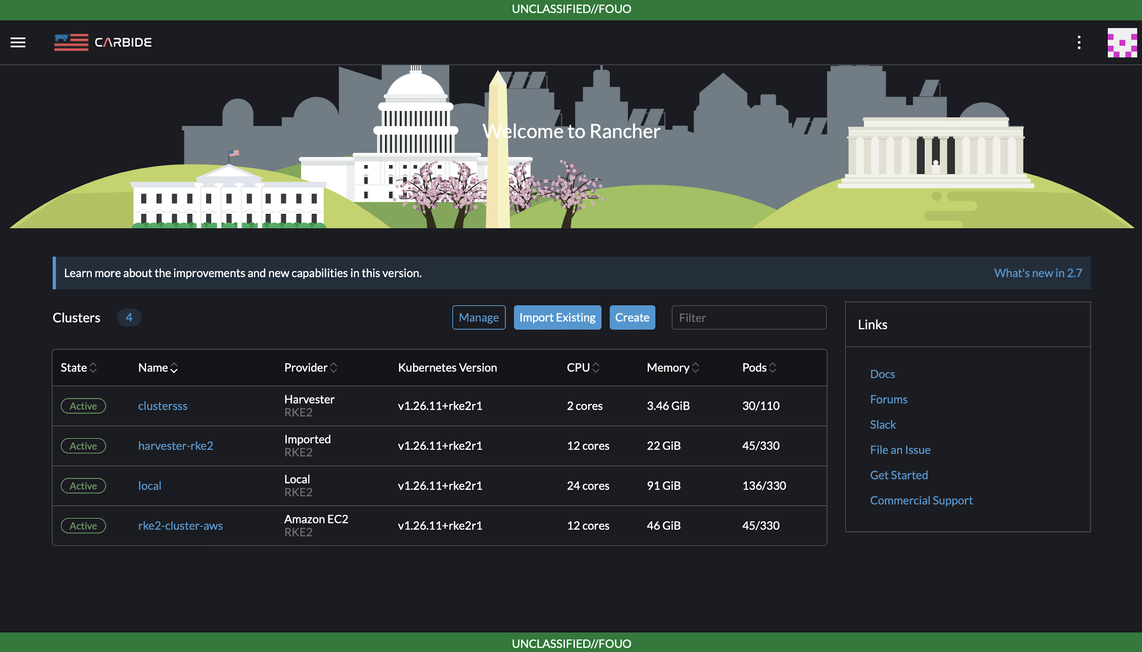
Rancher Government Carbide…
Available to all current and future supported customers!
Carbide Secured Registry (CSR) with SBOMs, CVE Reports, and Signed Images
STIGATRON (Observability and Validation for DISA STIGs)
Supply Chain Management Offline Rancher Docs
SLSA3/SBOMs/Scans
Built for our U.S. Government Support Customers (Licensed)
RGS Answer to E.O. 14028

Slide 13
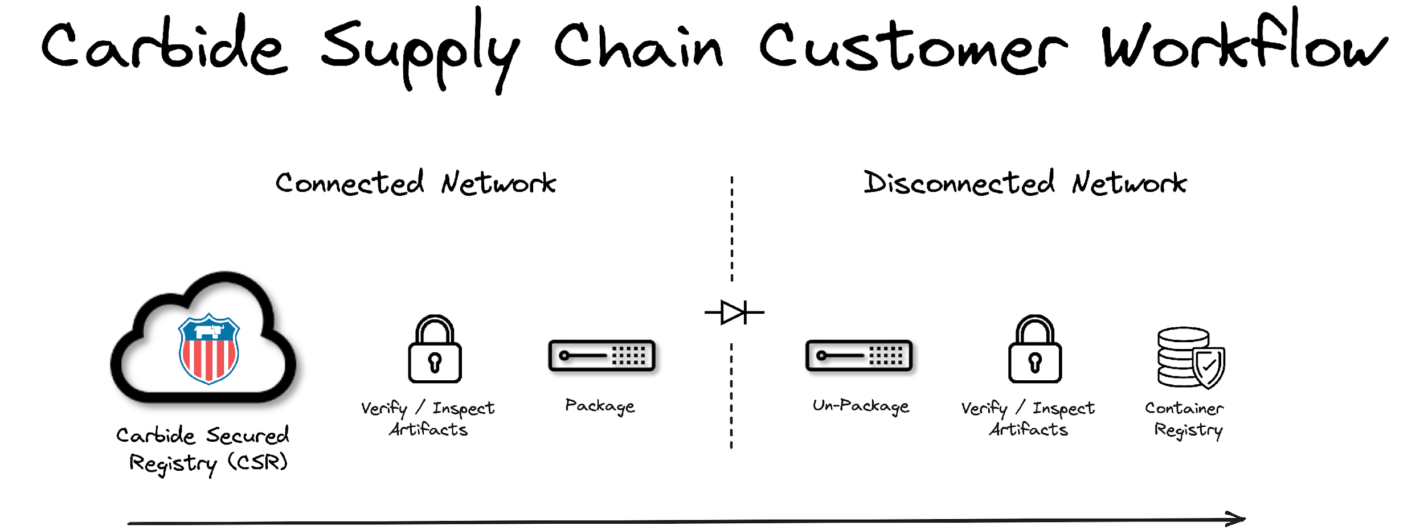

Notes:
Deeper dive into secure software pipeline flow

Slide 14
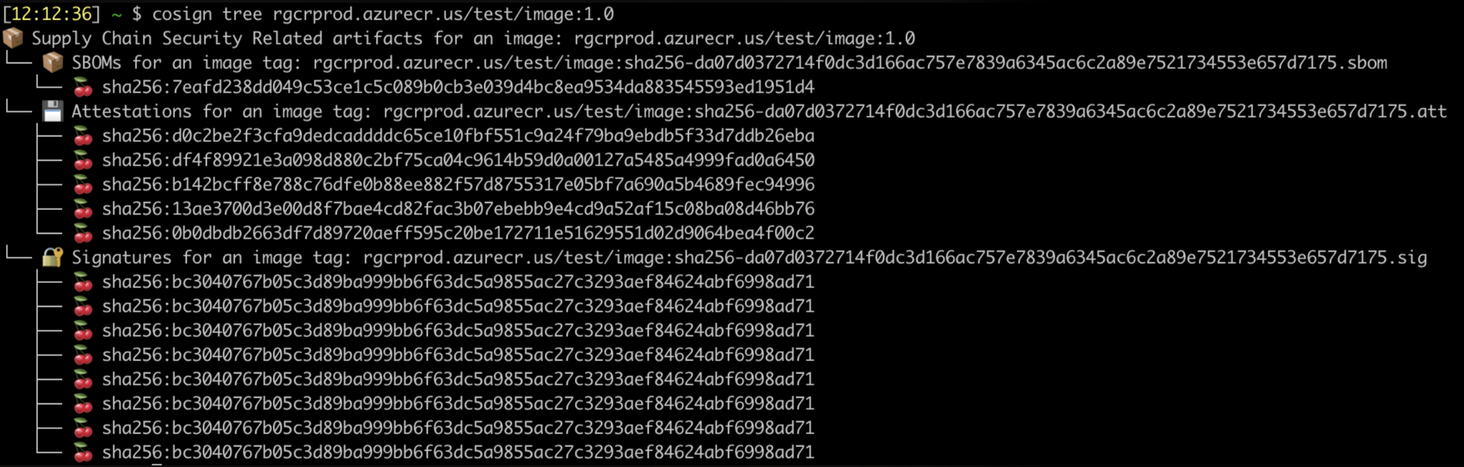
Hardened Images in the Carbide Secured Registry
‹#›

Slide 15

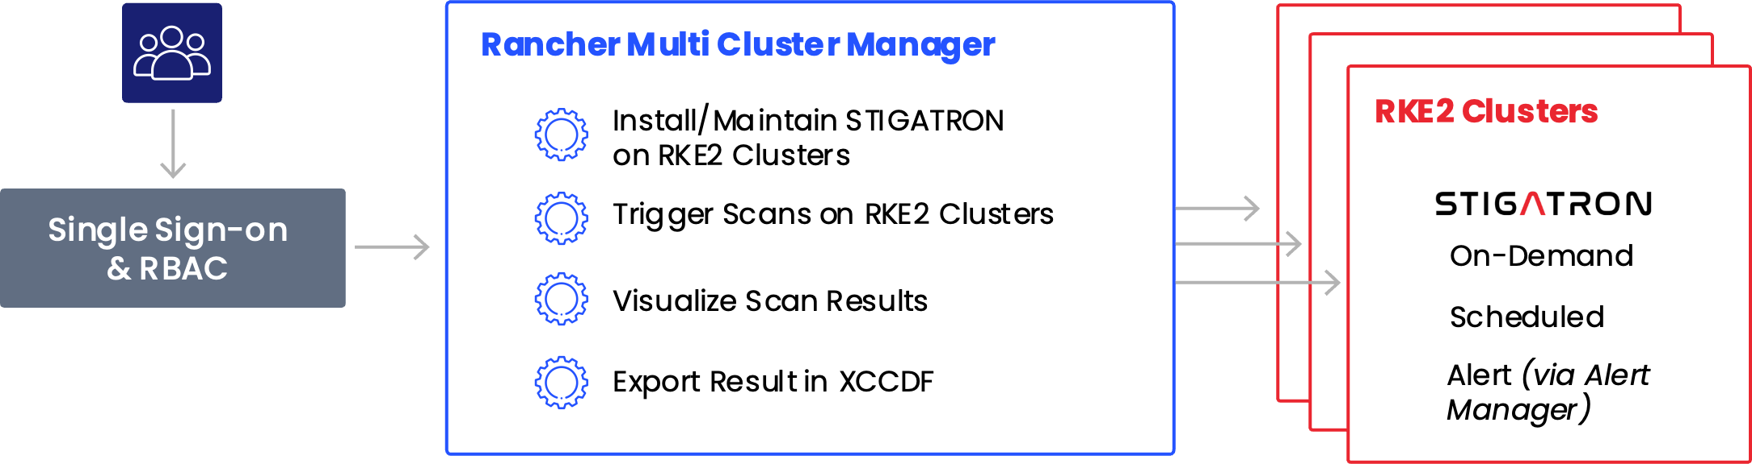
Validate downstream clusters compliance from the centralized Rancher Manager
Monitor
Empower
Streamline
and validate the DISA STIG integrity of downstream RKE2 Kubernetes clusters
system administrators to refocus their time on more meaningful initiatives
cyber auditing and compliance processes
Notes:
Deeper dive into STIGATRON

Slide 16
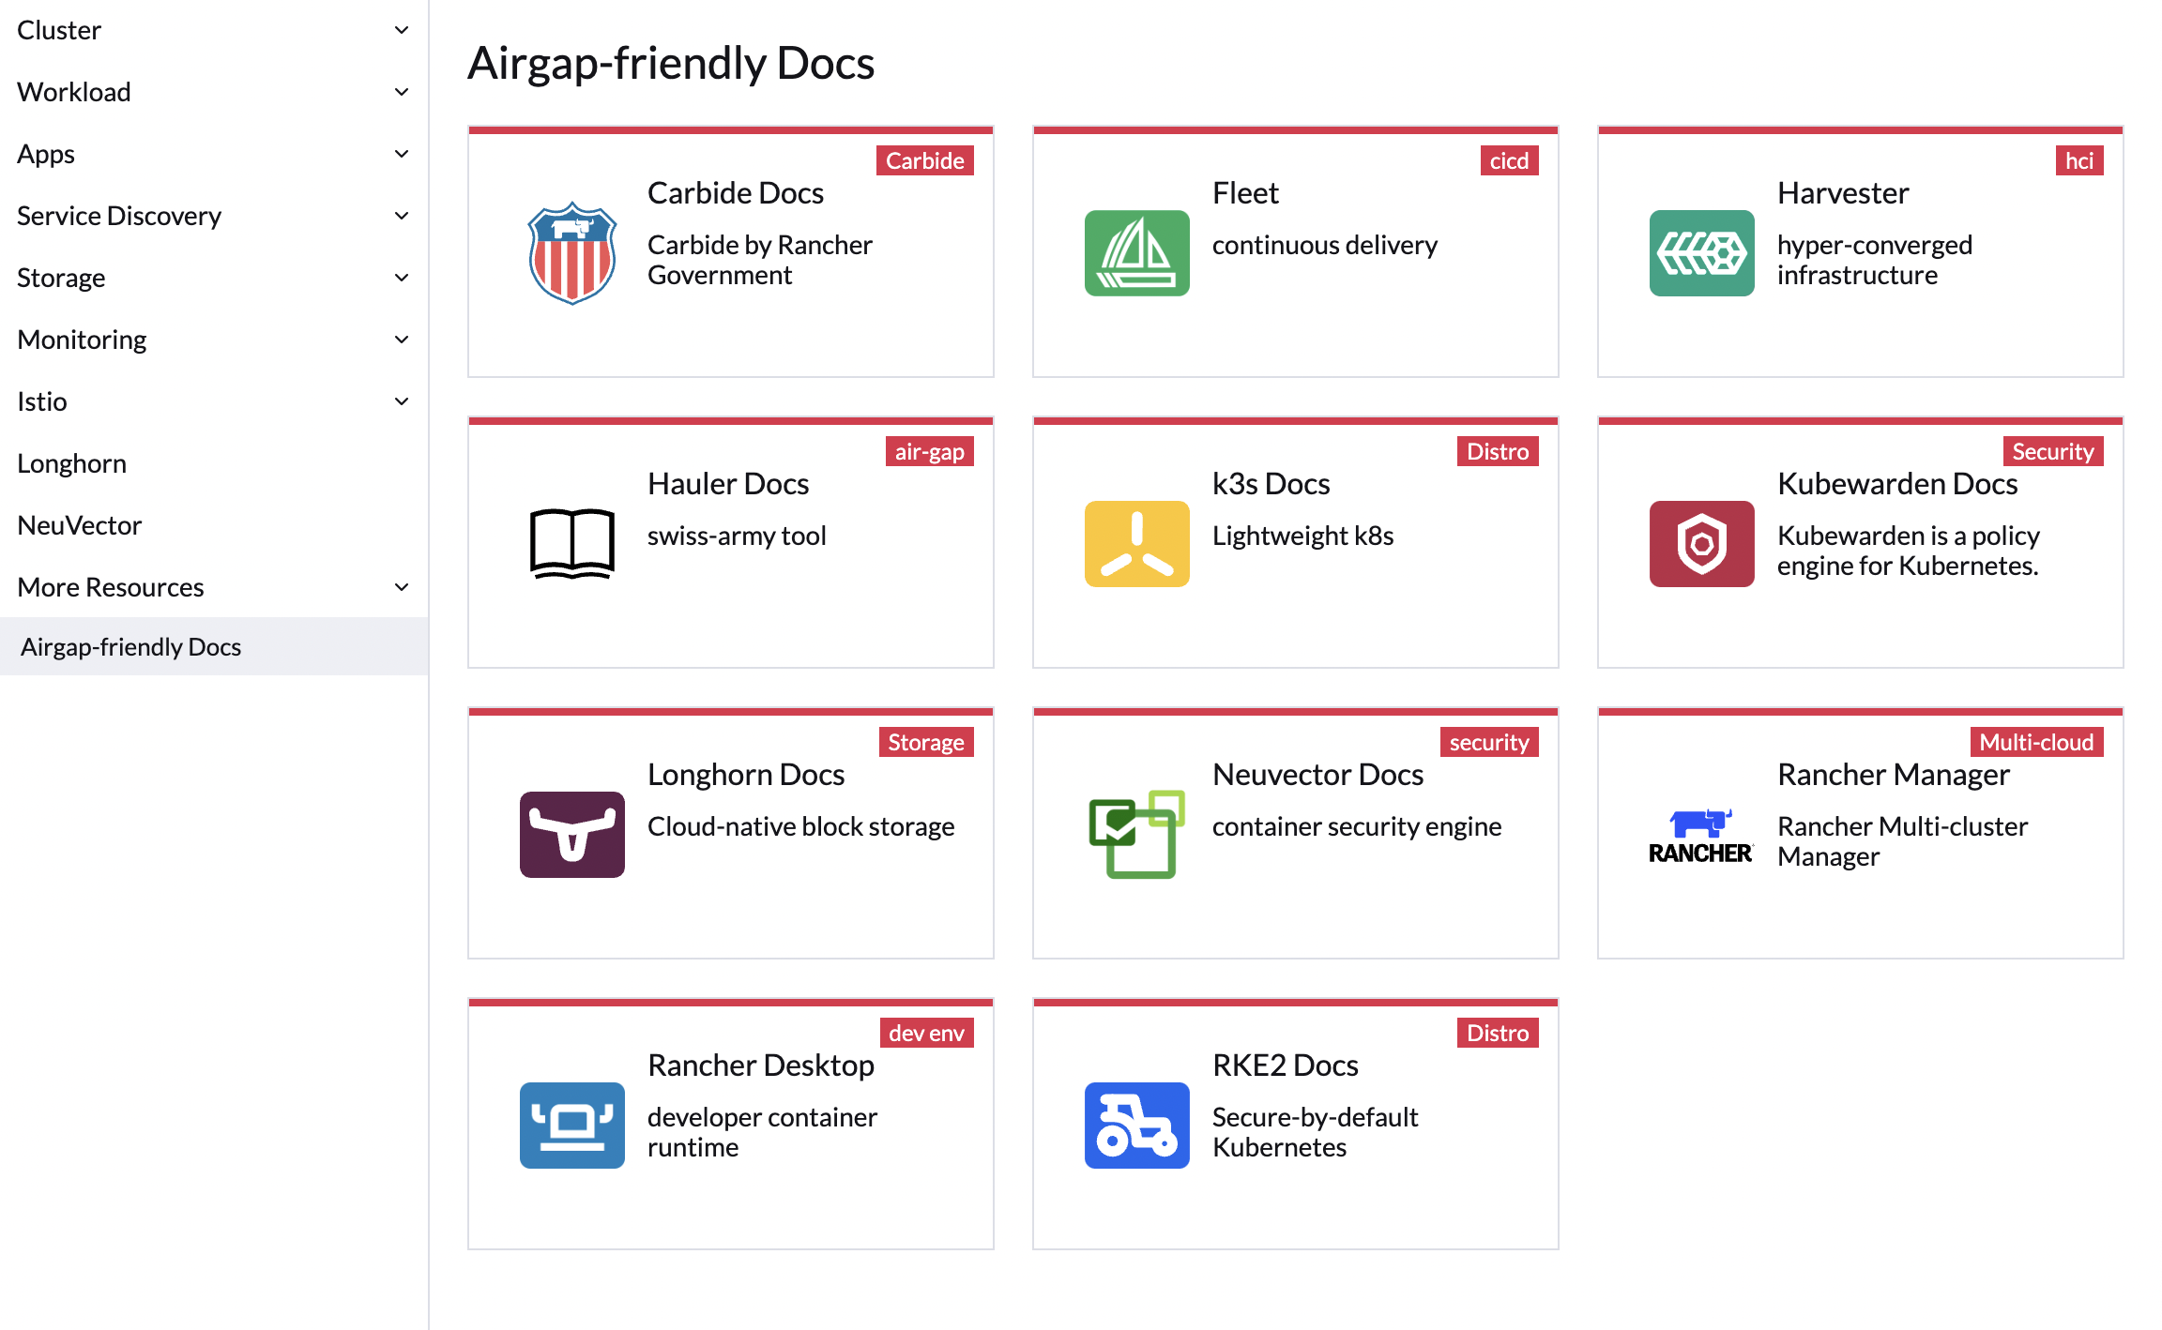
Airgapped/Offline Docs
‹#›

Slide 17

Rancher Government
Airgap Swiss Army Knife – Simplifying the Airgap Experience
Rancher Government Hauler simplifies the airgap experience without requiring the adoption of a specific workflow. Assets such as images, charts, and files are represented as collections and content within Hauler. Users can easily fetch, store, package, validate, and distribute these assets with declarative manifests or through the command line.
Rancher Government Hauler’s collections and content are stored as OCI Artifacts which enable users to serve these assets through an embedded registry and file server.

Slide 18
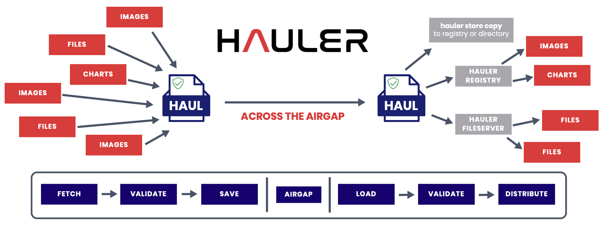

Slide 19
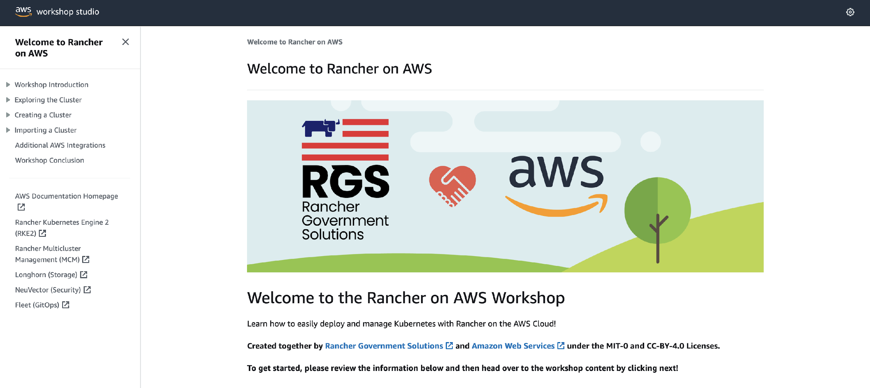
Rancher on AWS Workshop
Learn how to easily deploy and manage Kubernetes! https://catalog.workshops.aws/rancher
‹#›

Slide 20
Rancher Government Solutions + Amazon AWS
Rancher is the leading Kubernetes distribution and Kubernetes platform.
Amazon AWS is the leading and most adopted cloud provider.
But what does that mean for our customers?
Rancher Government Solutions and Amazon AWS have partnered together to develop public AWS Marketplace offerings to dramatically reduce the barrier to entry to Kubernetes in the cloud.
These listings provide a free trial or fully supported deployment of a preconfigured highly available deployment of RKE2/Rancher Manager on AWS GovCloud (U.S.), designed strictly for use only by U.S. Federal Government and Public Sector Customers.
https://tryranchergov.com
https://github.com/zackbradys/rancher-on-aws
‹#›

Slide 21
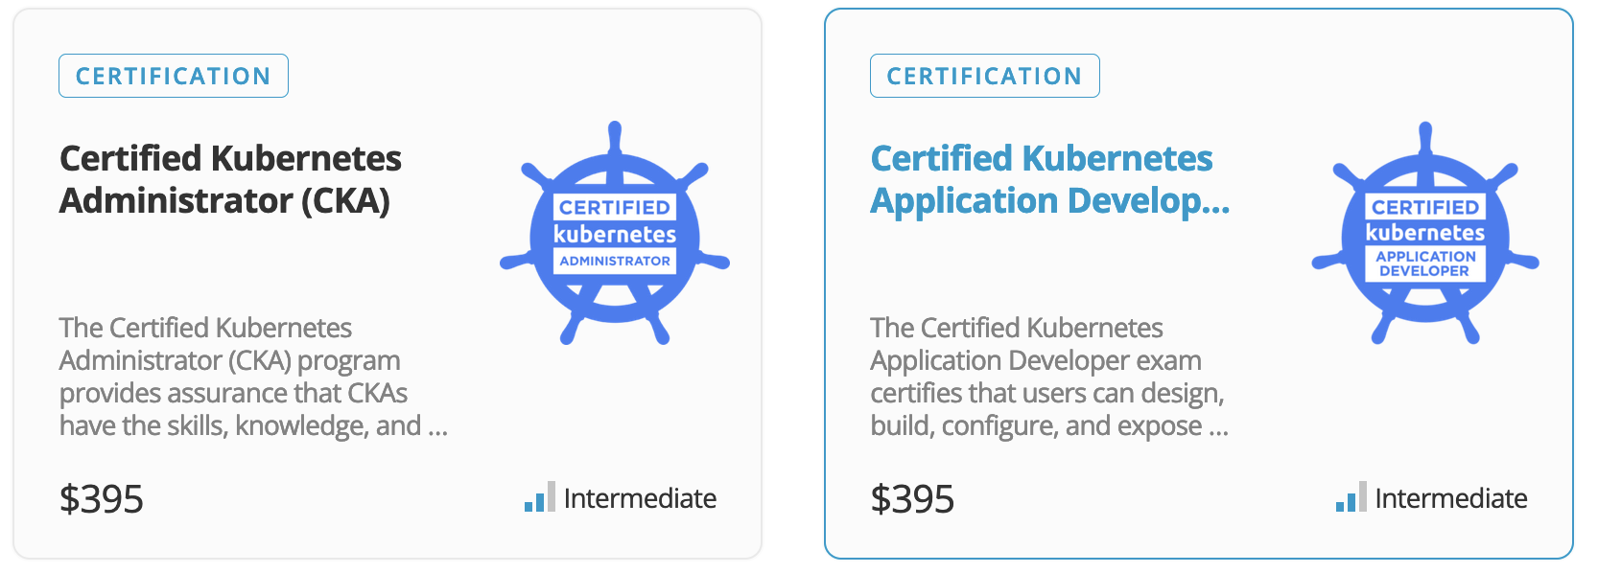

Included Enablement and Training Paths
The Linux Foundation is non-profit designed to build sustainable ecosystems around open-source projects to accelerate technology development and commercial adoption.
Included with the Rancher Multi-Cluster Manager Subscription:
1 Year Subscription to the complete Linux Foundation eLearning Catalogue
1 Individual Linux Foundation Certification
Additional subscriptions available via the RGS-Linux Foundation Customer Portal

Slide 22
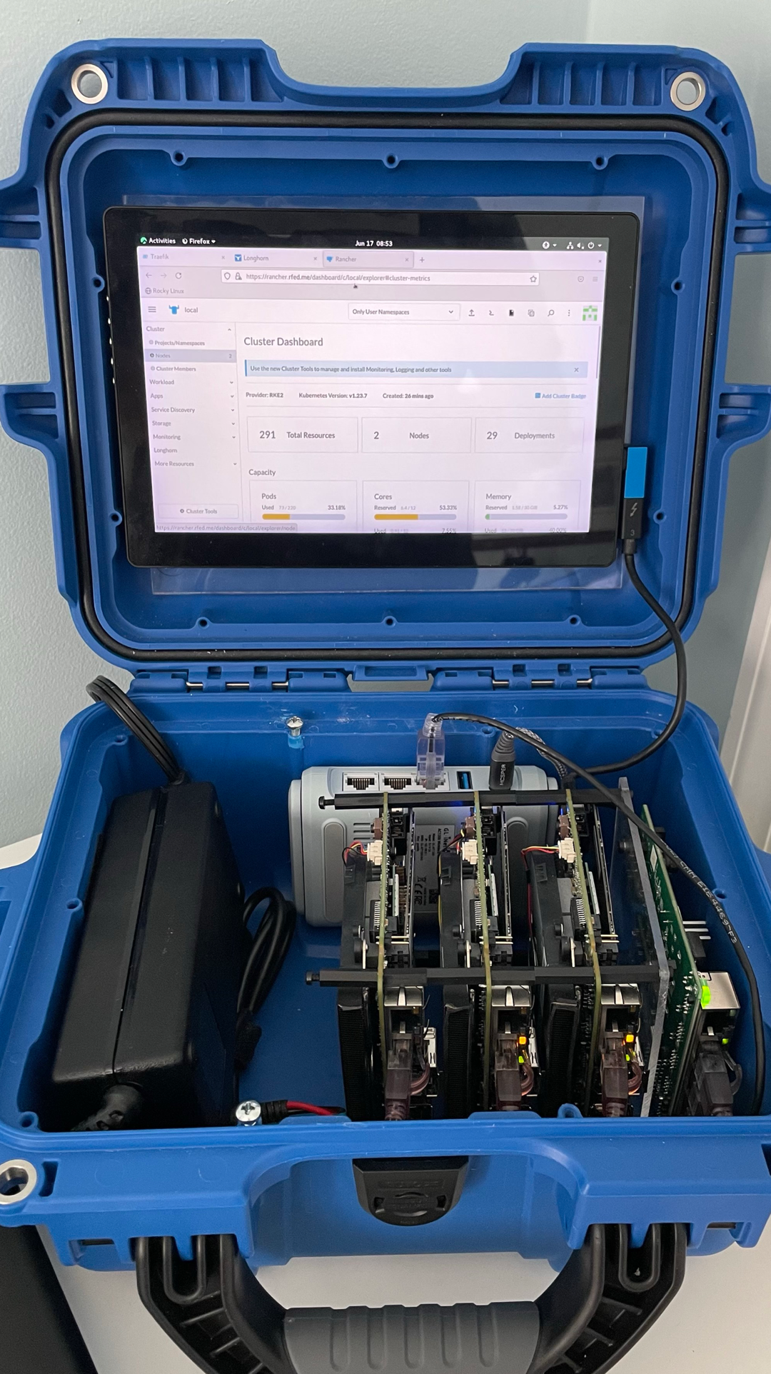
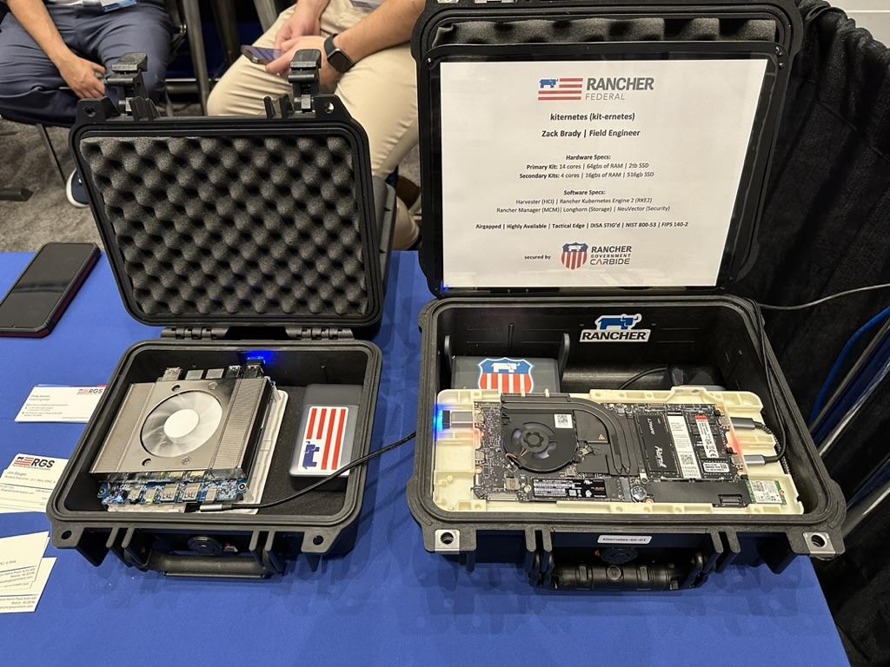
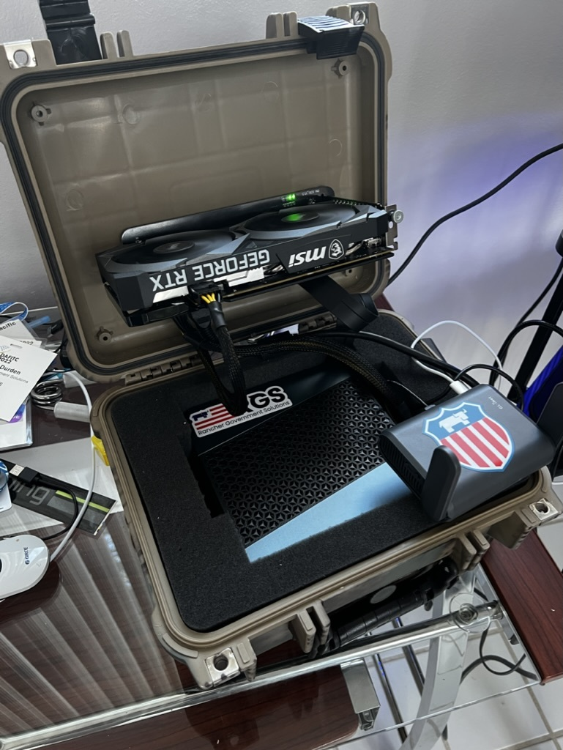
From Datacenters to the Edge…
‹#›

Slide 23

Why the Rancher Ecosystem
Not all Kubernetes management solutions are created equal
Rancher is Easy to install and manage
Easy to stand up and operate in airgapped environments
Fully open and interoperable across all infrastructure platforms
Eliminates total vendor lock-in to proprietary technology stacks
Unlimited scalability across any enterprise from the data center to the edge
Meets or exceeds all federal government and DoD security requirements
Trusted & ATO’d across the Federal Government, including the DoD & IC
Notes:
‹#›

Slide 24

Questions? Concerns?
and then our…
Technical Demo/Workshop!
http://resources.ranchers.io

Slide 25
http://resources.ranchers.io
Thank you for your time today!
Email: zack.brady@ranchergovernment.com
GitHub: https://github.com/zackbradys
Website: https://ranchergovernment.com
CAGE Code: 8GLZ3
DUNS: 117387835

Slide 26























Rancher is always Meeting You At Your Mission
Platform Services
Security
Developer Services
- Multi-Cluster & Multi-Cloud Kubernetes Management
Authentication
App Catalog, Observability, Storage & Networking
App Catalog
Monitoring & Alerts
Persistent Storage
Service Mesh
Application Deployment
Compliance & SUSE Linux Scans
Policy Enforcement & Governance
Local Development
LDAP
Centralized Audit & CIS Benchmarking
AIOps, Monitoring & Logging
RBAC, Pod & Network Policies
OPA & KubeWarden
Pipeline Security Automation
Simplified Cluster Operations & Infrastructure Management
Container Image
Cluster Provisioning & Lifecycle Management
K8S Versioning & GitOps CD
Cluster Templates & Config Enforcement
Rancher Hosted
Virtual Machine & OS Management
SLE BCI
Zero-Trust Controls & File Protection
Infrastructure Services
1 & 2
Any CNCF K8s
Advanced Network Security
Amazon
EKS
Azure
AKS
Google
GKE
SLE Micro
Servers
Containers
VM
IaaS
CaaS
Servers
Device
VM
Automated Protection Modes
On-prem
Cloud
Edge
‹#›
Notes:
‹#›

Slide 27
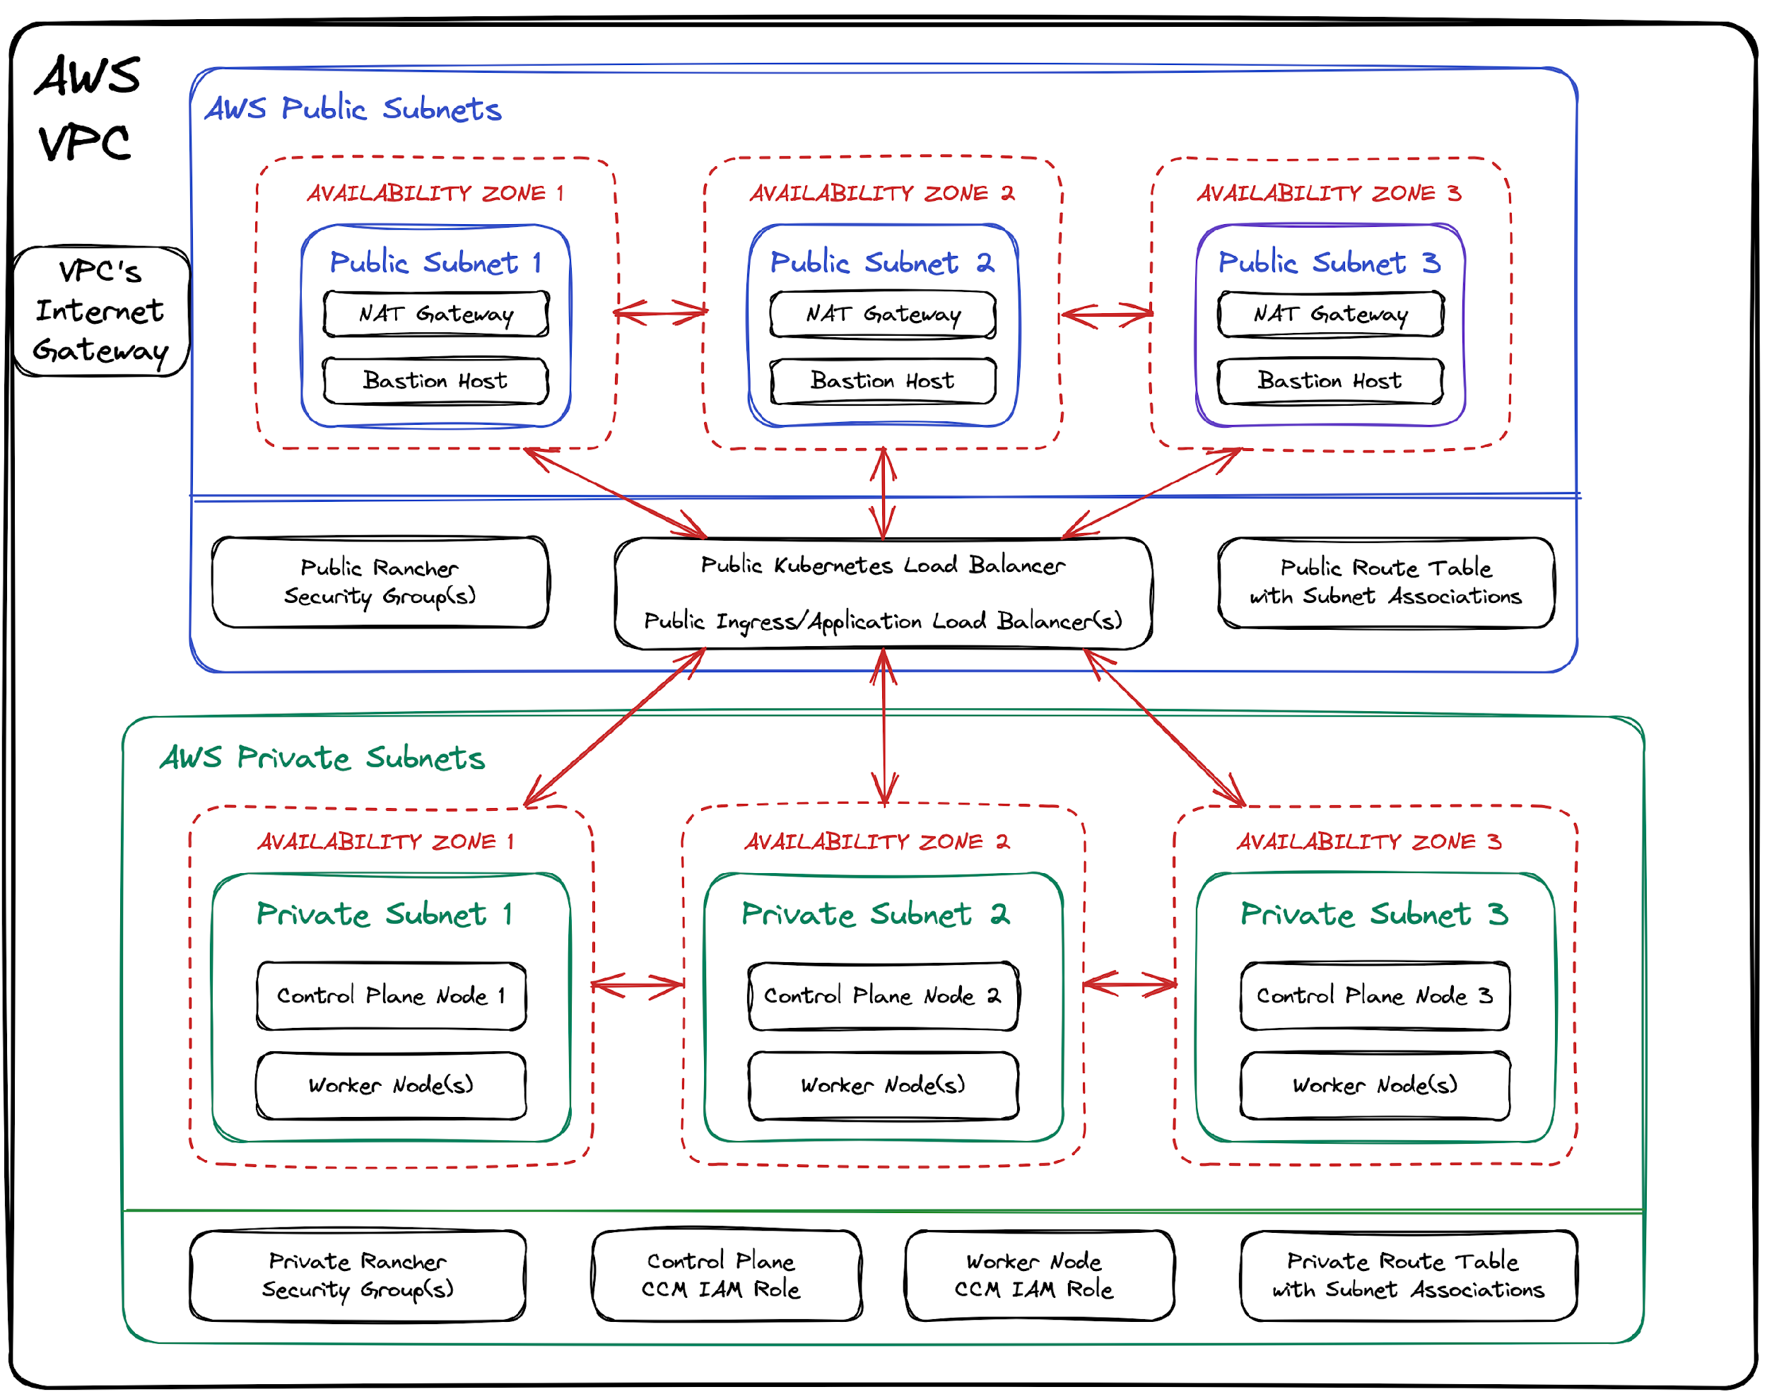

Slide 28

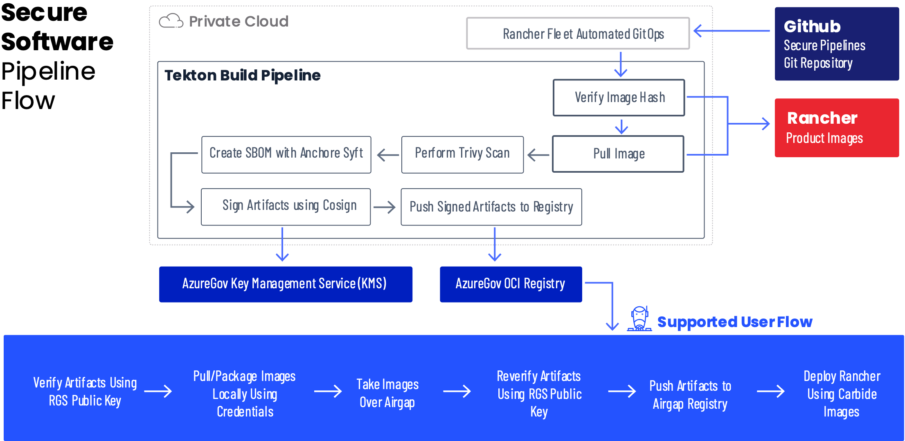
Carbide Supply Chain Security
Enabled by the Rancher Government Carbide Secured Registry (CSR)
Notes:
Deeper dive into secure software pipeline flow

Slide 29





Recommended Architecture
Rancher Management Server Cluster
Rancher Management Server Cluster
Highly Available
Node
Node
Node
Production Environment
Additional Environments
Highly Available
Node
Node
Node
(cp/etcd/worker)
(cp/etcd/worker)
Cluster 1 (Prod)
Cluster 2 (Prod)
Cluster 1 (Dev/Test)
Cluster 2 (Dev/Test)
Control Plane
Node
Node
Control Plane
Node
Node
Control Plane
Node
Node
Control Plane
Node
Node
etcd
Node
Node
Node
etcd
Node
Node
Node
etcd
Node
Node
Node
etcd
Node
Node
Node
Worker
Node
Node
Node
Worker
Node
Node
Node
Worker
Node
Node
Node
Node
Worker
Node
Node
Node
Node
Cluster 3 - Hosted (Prod)
Control Plane
Node
Node
Cloud Hosted Environment on GKE, EKS, AKS, etc
The Rancher Management Server cluster manages all downstream k8s. The k8s required to run Rancher are not counted in the downstream Rancher host count
etcd
Node
Node
Node
Rancher hosts are the downstream Kubernetes compute nodes managed by the Rancher Management Server cluster
Worker
Node
Node
Node
Node
Longhorn storage nodes managed by Rancher management server
No cost
‹#›

